Slide 1

Grammars
Grammars express languages
Example: the English language grammar

Slide 2
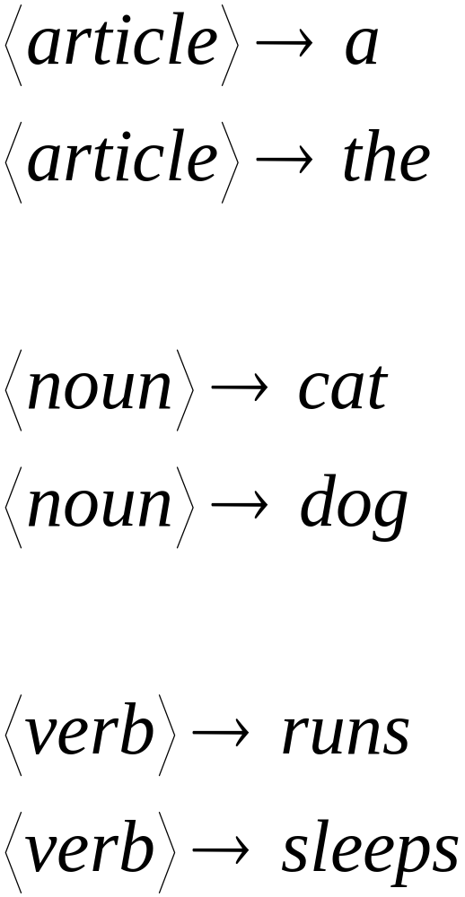

Slide 3
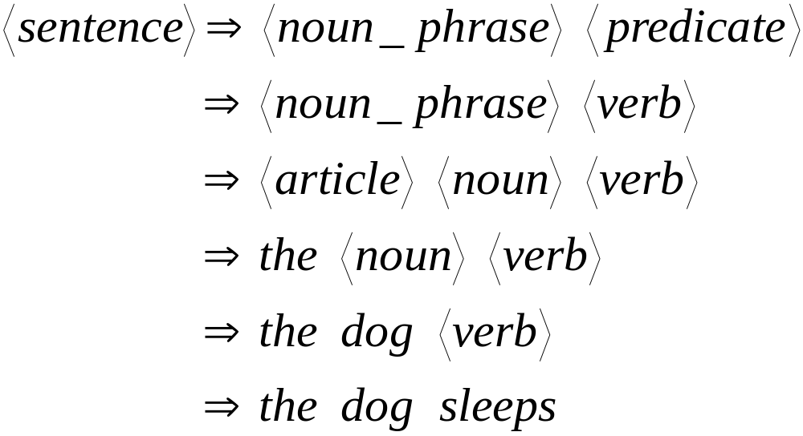
Derivation of string “the dog sleeps”:

Slide 4
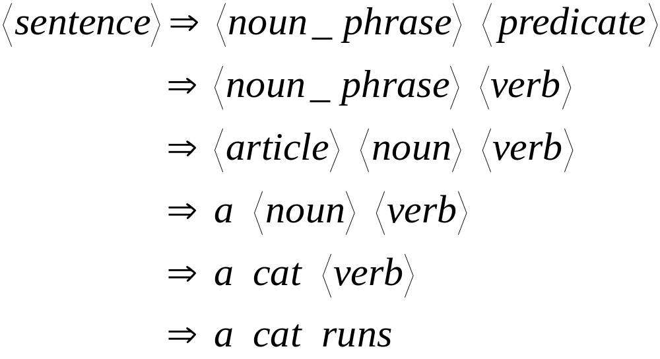
Derivation of string “a cat runs”:

Slide 5
Language of the grammar:
L = { “a cat runs”,
“a cat sleeps”,
“the cat runs”,
“the cat sleeps”,
“a dog runs”,
“a dog sleeps”,
“the dog runs”,
“the dog sleeps” }

Slide 6
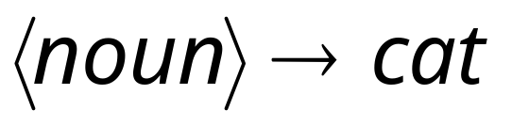
Productions
Sequence of
Terminals (symbols)
Variables
Sequence of Variables

Slide 7
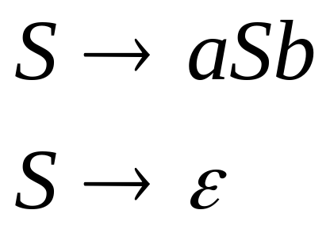

Another Example
Sequence of
terminals and variables
Grammar:
Variable
The right side
may be

Slide 8
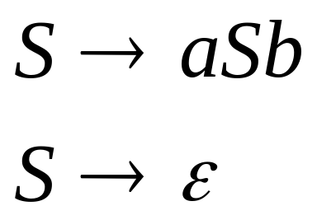



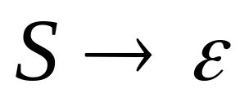
Grammar:
Derivation of string :

Slide 9


Grammar:
Derivation of string :

Slide 10

Grammar:
Other derivations:

Slide 11

Grammar:
Language of the grammar:

Slide 12

A Convenient Notation
We write:
Instead of:
for zero or more derivation steps

Slide 13

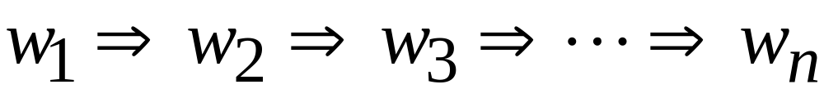
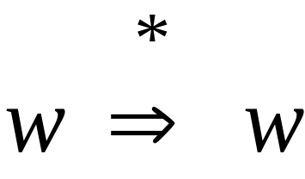
In general we write:
If:
in zero or more derivation steps
Trivially:

Slide 14

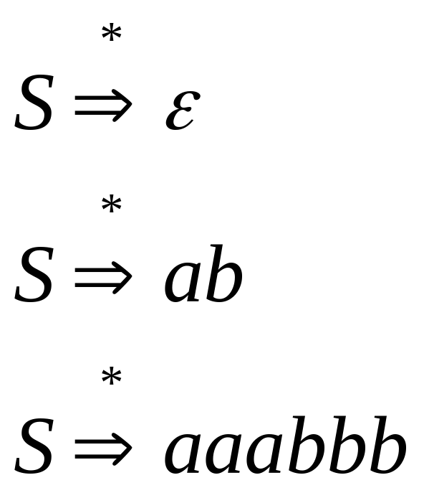
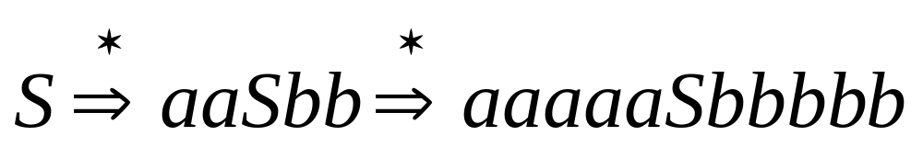
Example Grammar
Possible Derivations

Slide 15
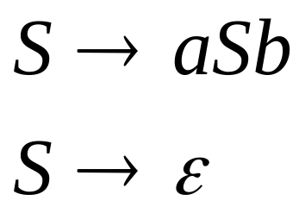
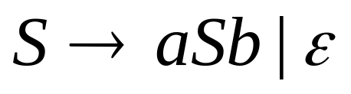
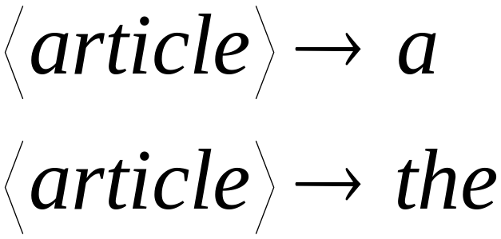
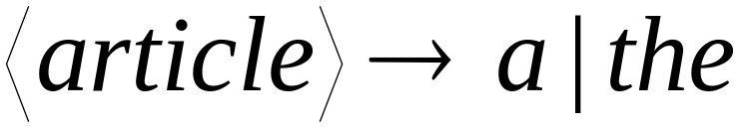
Another convenient notation:

Slide 16

Formal Definitions
Grammar:
Set of
variables
Set of
terminal
symbols
Start
variable
Set of
productions

Slide 17

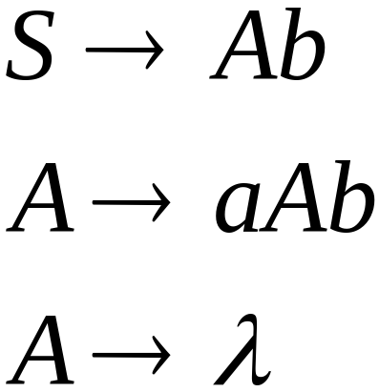
Linear Grammars
Grammars with
at most one variable at the right side
of a production
Examples:

Slide 18

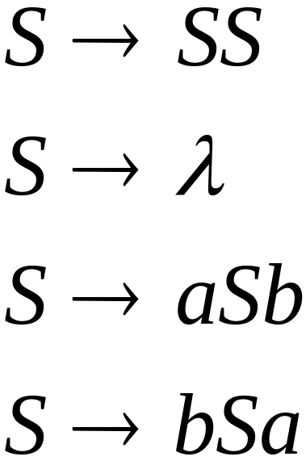
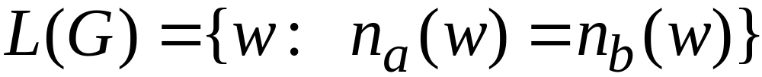


A Non-Linear Grammar
Grammar :
Number of in string

Slide 19
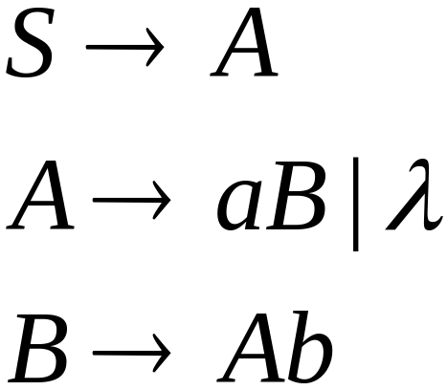
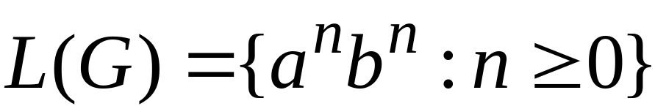
Another Linear Grammar
Grammar :

Slide 20


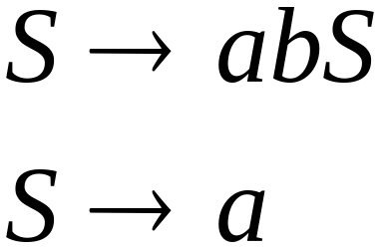
Right-Linear Grammars
All productions have form:
Example:
or
string of
terminals

Slide 21

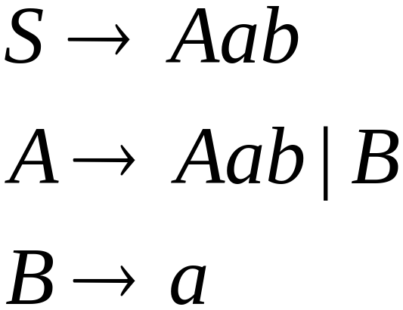
Left-Linear Grammars
All productions have form:
Example:
or
string of
terminals

Slide 22
Regular Grammars

Slide 23
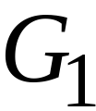
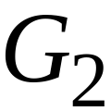
Regular Grammars
A regular grammar is any
right-linear or left-linear grammar
Examples:

Slide 24
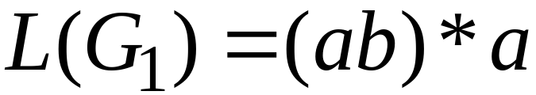
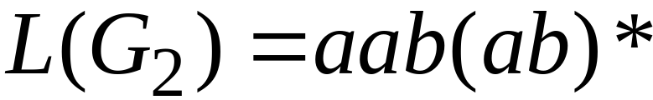
Observation
Regular grammars generate regular languages
Examples:

Slide 25
Regular Grammars
Generate
Regular Languages

Slide 26

Theorem
Languages
Generated by
Regular Grammars
Regular
Languages

Slide 27
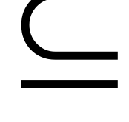
Theorem - Part 1
Languages
Generated by
Regular Grammars
Regular
Languages
Any regular grammar generates
a regular language

Slide 28

Theorem - Part 2
Languages
Generated by
Regular Grammars
Regular
Languages
Any regular language is generated
by a regular grammar

Slide 29
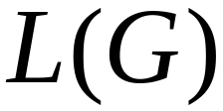
Proof – Part 1
Languages
Generated by
Regular Grammars
Regular
Languages
The language generated by
any regular grammar is regular

Slide 30

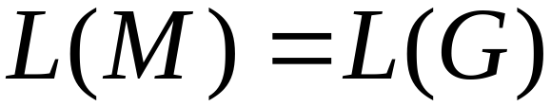
The case of Right-Linear Grammars
Let be a right-linear grammar
We will prove: is regular
Proof idea: We will construct NFA
with

Slide 31
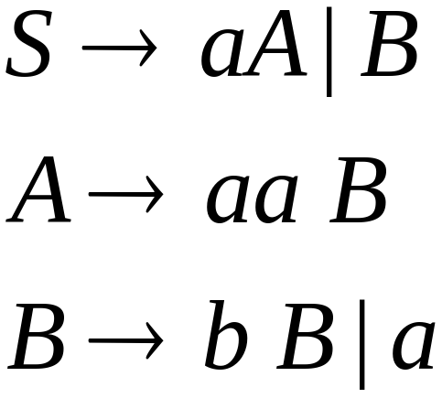
Grammar is right-linear
Example:

Slide 32



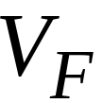

Construct NFA such that
every state is a grammar variable:
special
final state

Slide 33


Add edges for each production:

Slide 34

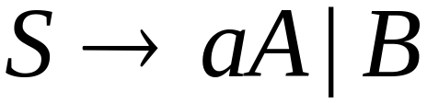

Slide 35
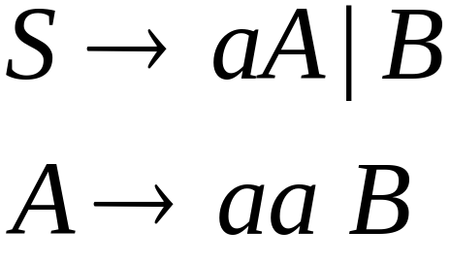

Slide 36
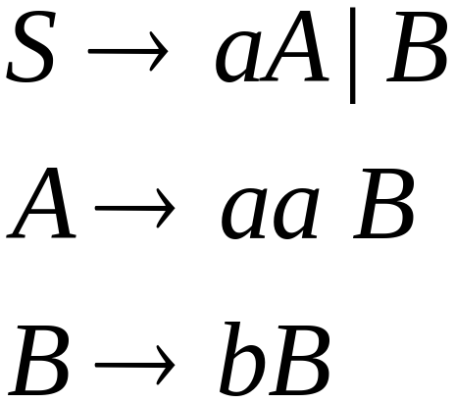


Slide 37
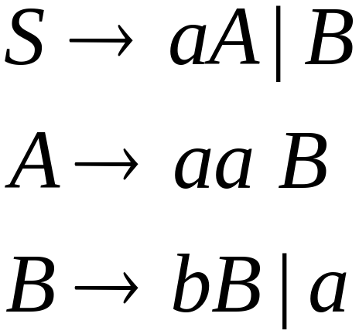

Slide 39
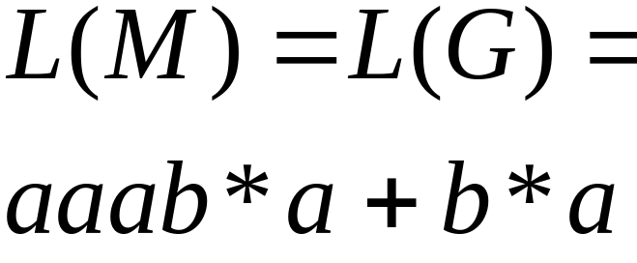
NFA
Grammar

Slide 40
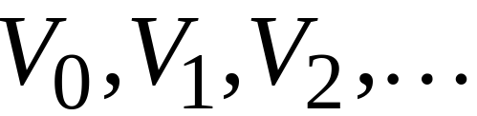
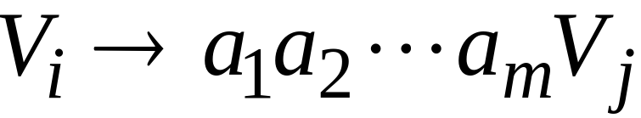
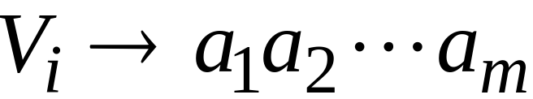
In General
A right-linear grammar
has variables:
and productions:
or

Slide 41






We construct the NFA such that:
each variable corresponds to a node:
special
final state

Slide 42


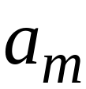


For each production:
we add transitions and intermediate nodes
………

Slide 43
For each production:
we add transitions and intermediate nodes
………

Slide 44







Resulting NFA looks like this:
It holds that:

Slide 45
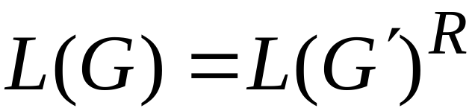

The case of Left-Linear Grammars
Let be a left-linear grammar
We will prove: is regular
Proof idea:
We will construct a right-linear
grammar with

Slide 46
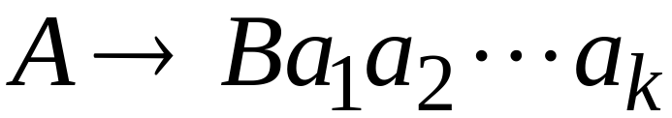
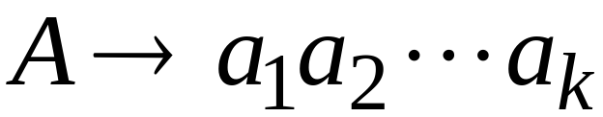
Since is left-linear grammar
the productions look like:

Slide 47

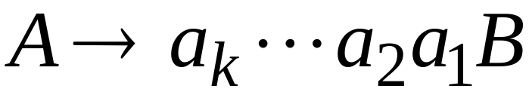
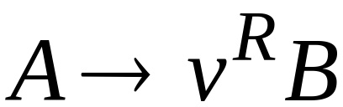
Construct right-linear grammar
Left
linear
Right
linear

Slide 48

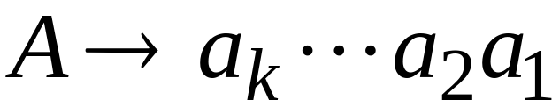
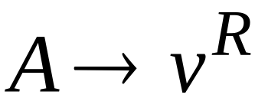
Construct right-linear grammar
Left
linear
Right
linear

Slide 49
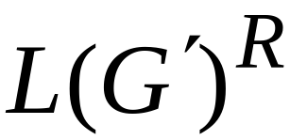
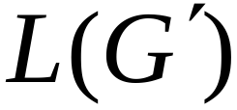
It is easy to see that:
Since is right-linear, we have:
Regular
Language
Regular
Language
Regular
Language

Slide 50

Proof - Part 2
Languages
Generated by
Regular Grammars
Regular
Languages
Any regular language is generated
by some regular grammar

Slide 51
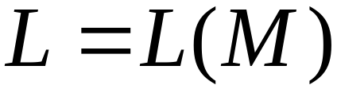
Any regular language is generated
by some regular grammar
Proof idea:
Let be the NFA with .
Construct from a regular grammar
such that

Slide 52





Since is regular
there is an NFA such that
Example:

Slide 53




Convert to a right-linear grammar

Slide 54


Slide 55


Slide 56



Slide 57



In General
For any transition:
Add production:
variable
terminal
variable

Slide 58


For any final state:
Add production:

Slide 59
Since is right-linear grammar
is also a regular grammar
with

